Slide 1

Marketing Your Business

Slide 2
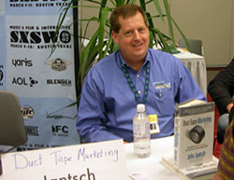
Know, Like, and Trust
Notes:
John Jantsch, author of Duct Tape Marketing, widely recognized small business marketing guru, defines marketing as how you get the right people to know, like, and trust you.

Slide 3
Example: Borland International
Millions
Notes:
The main point is demand, need for the product
Pascal was needed by lots of people
Market was new, mostly hackers
Demand-driven business is rare
Channels decision in 84: Good example of situation-driven strategy

Slide 4

Example: Challenge ‘95
Millions
Notes:
Latin America 1980s
Market-driven Strategy
Blue Sky problem
Strategy Pyramid
$2-$40 million ’83-’87
Japan 1990-94
User-need Strategy
Alliance strategy
Unit share 0 to 20%
Sales $180M to $1.5B Note different scale
Role as a consultant: observations
Explain blue sky strategy
Strategy pyramid comes later
The point in Apple Japan: Simple. Effective. They stuck to it.

Slide 5

Example: Palo Alto Software
Source: NPD Intellect, formerly PC Data
Notes:
Point: long-term, consistency
Marketing Strategy
Root canal theory
We can’t hunt where the ducks are. We lure them to us. For which we use bplans.com
Sell benefits, deliver value
Stick to contiguous markets (product and market)
That comes later …
Just set the scene now

Slide 6
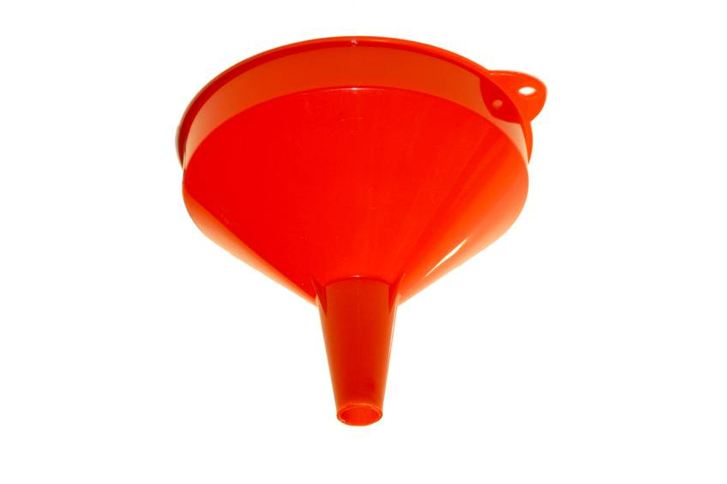
The Sales and Marketing Funnel

Slide 7
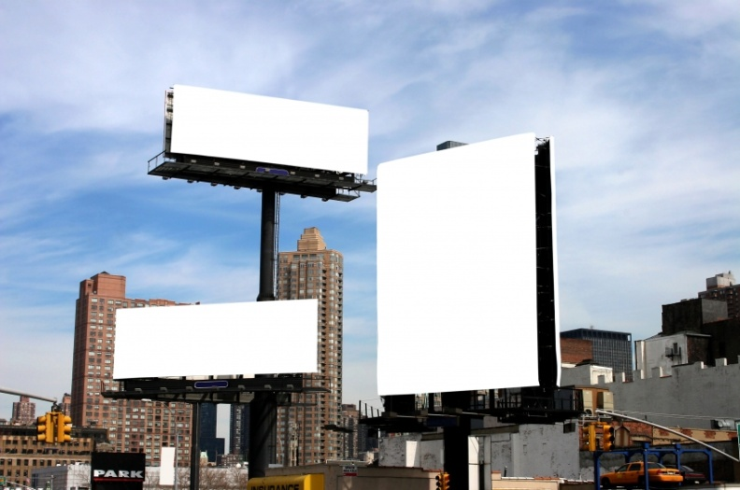
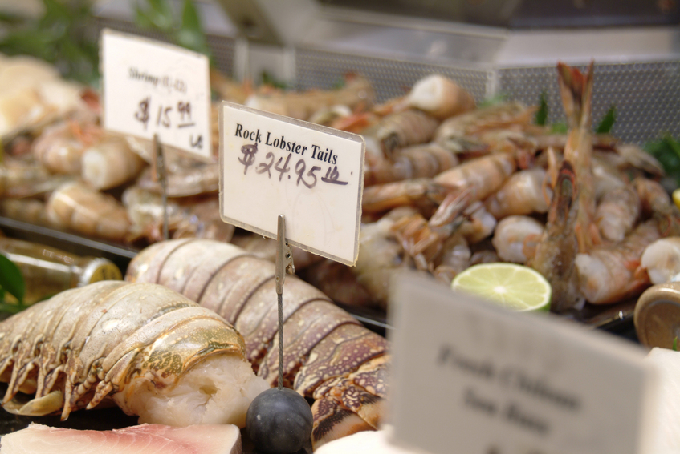
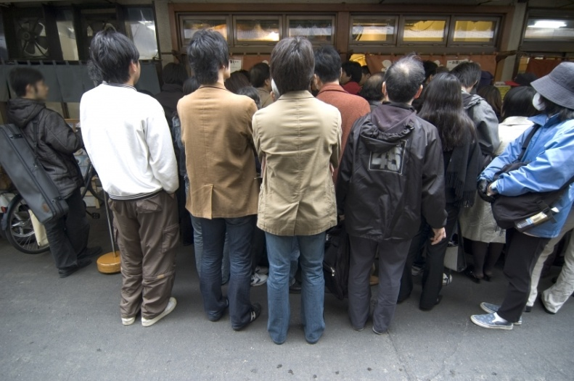
Marketing Mix
Notes:
All those Ps:
Product
Place (distribution channel and distribution strategy)
Promotion (advertising, PR, website)
Price
Position

Slide 8
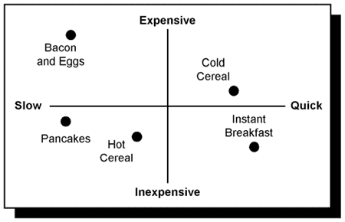
Basic Positioning

Slide 9

It’s All Positioning
Technical
Excellence
Lowest
Price!
Always!
We Will
Match
Anybody!
Segment
Expertise
Notes:
Some Classics
Volvo
McDonalds
For Your Own Company
Open inquiry
Pull from team
Pull from customers
Question assumptions
Can you change over time?
How much? Why?

Slide 10
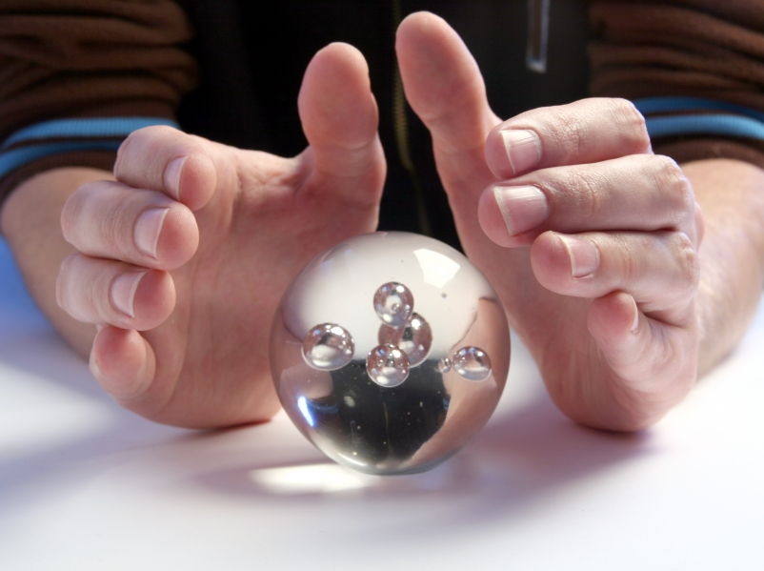
Pricing is Magic

Slide 11
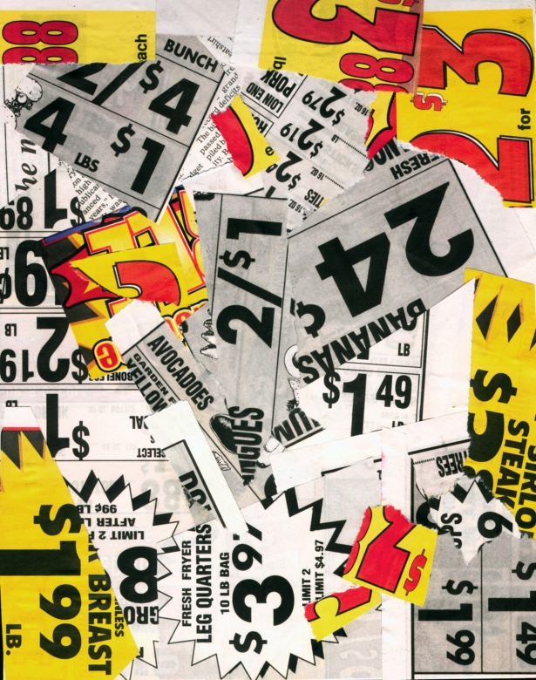
Don’t Price Too Low
Low price ≠ high volume
High price = high quality
Price premium

Slide 12
Premium Pricing, Quality, Service

Slide 13


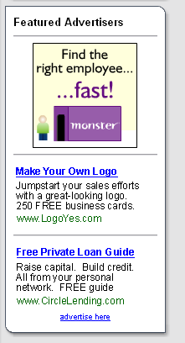
Advertising
Technical
Excellence
Lowest
Price!
Always!
We Will
Match
Anybody!
Segment
Expertise

Slide 14
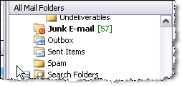
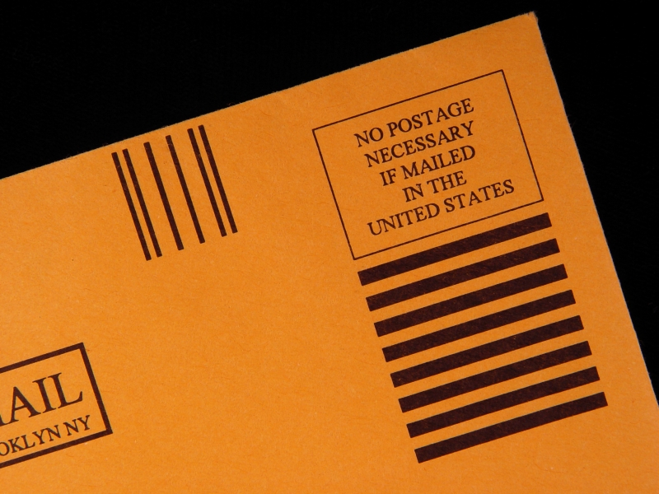
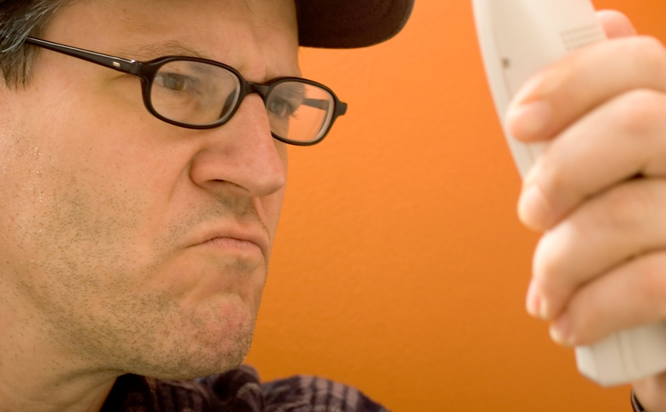
Direct Commications
Notes:
Direct mail
Spam
Direct telephone marketing

Slide 15
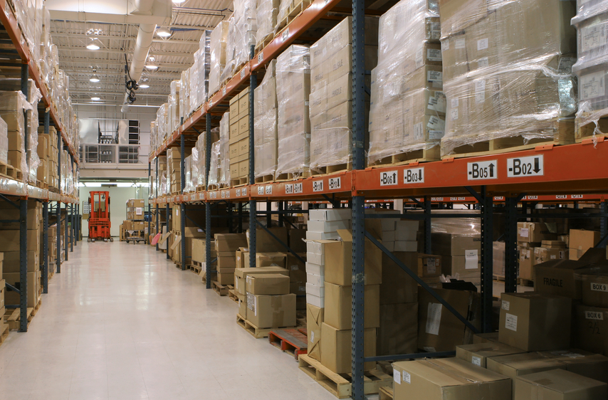
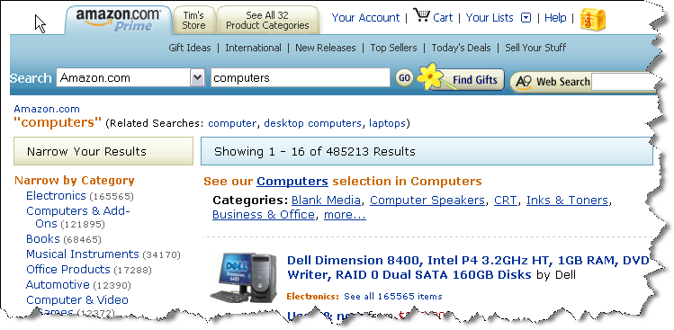
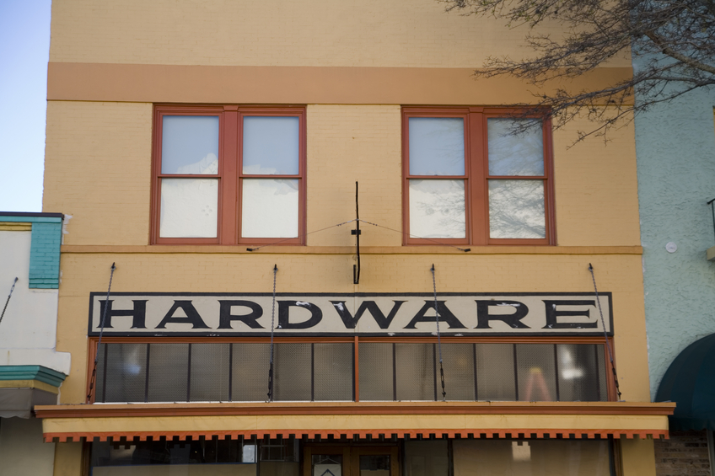
Channels of Distribution

Slide 16

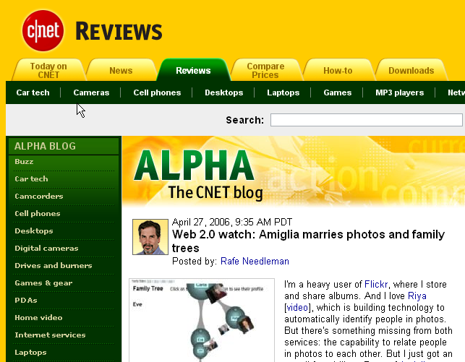
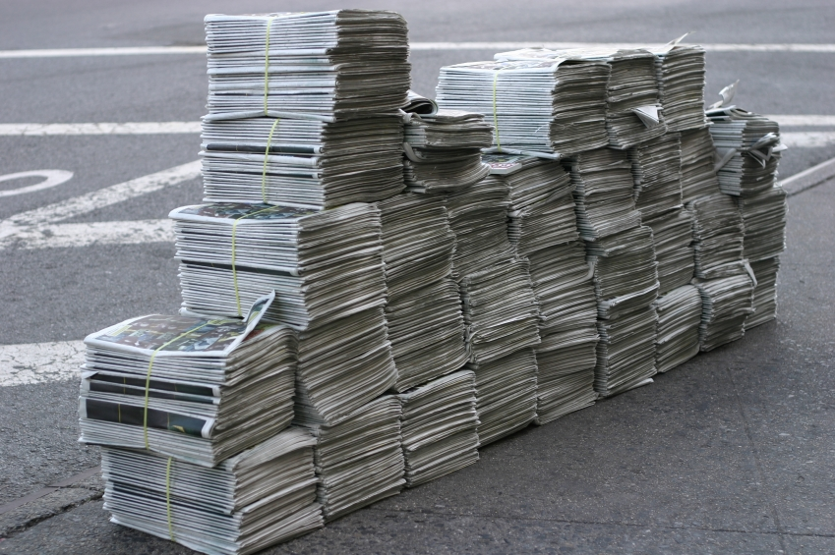

Public Relations

Slide 17
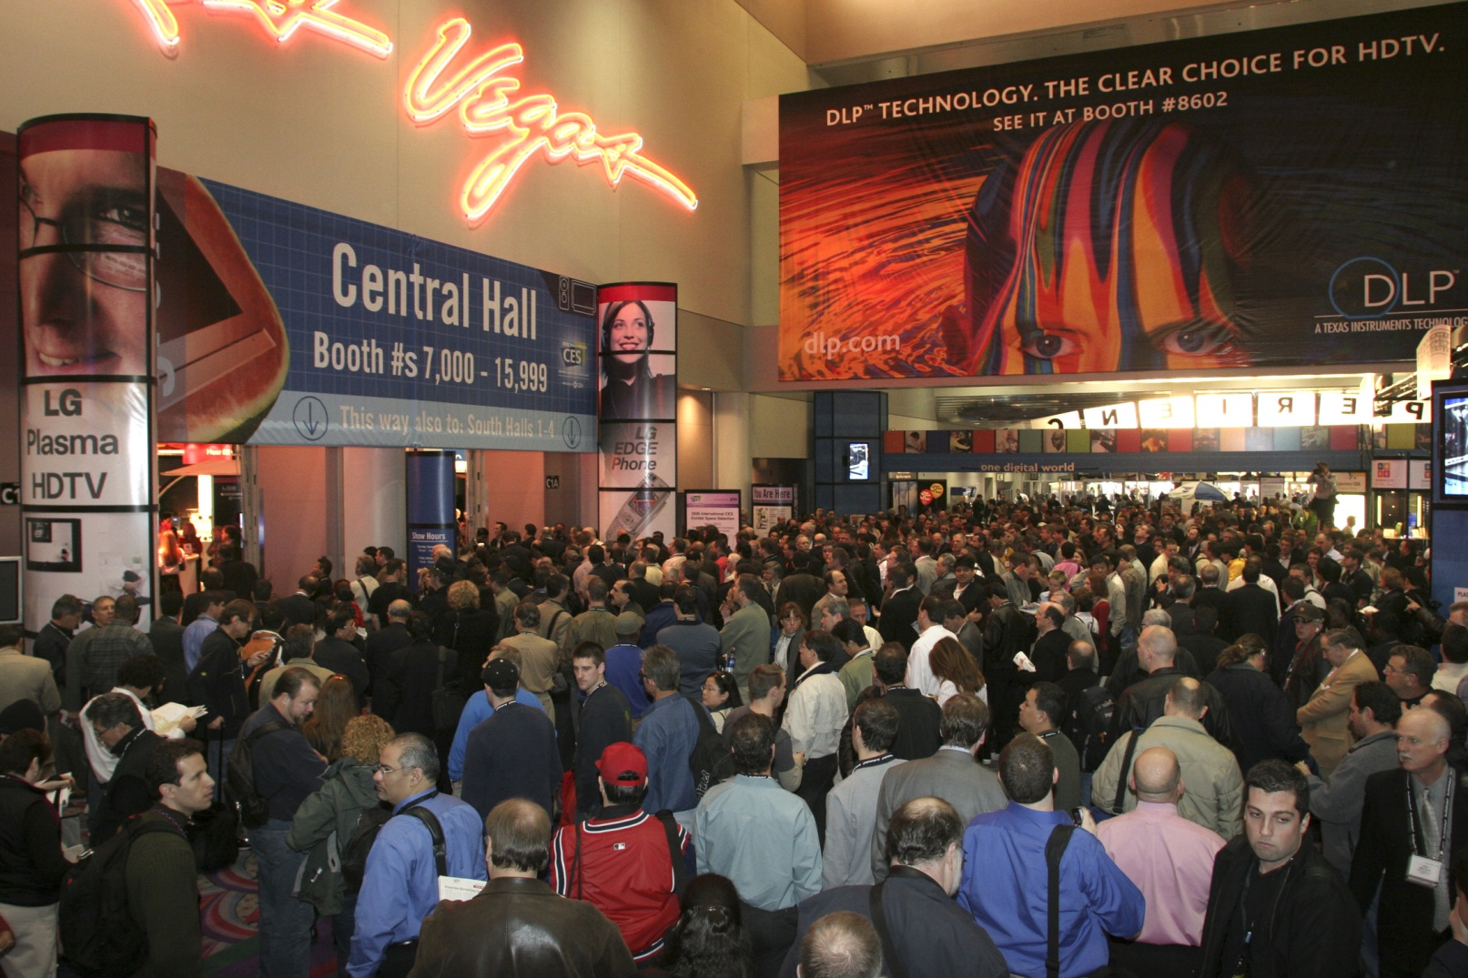
Trade Shows

Slide 18
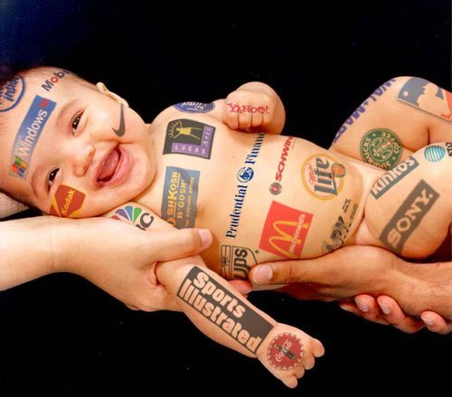
Branding
Image from www.funmovies-gratis.com
May be subject to copyright

Slide 19

Target Marketing

Slide 20
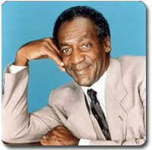
A Final Thought…
Notes:
Bill Cosby, entertainer, PhD in Education:
“I don’t know the secret to success, but I do know that trying to please everybody is the secret to failure.”

